Slide 1

Data Visualization
basics
Nikolay Nedyalkov
Petar Horozov
Senior QA Engineer
Senior QA Engineer
XAML Team 4
XAML Team 4
Telerik QA Academy

Slide 2

Table of Contents
What is Data Visualization
Graphs
Graph Types
Bar Chart
Line Chart
Scatter Points Chart
Axes Types

Slide 3
What is Data Visualization
It is the study of the visual representation of data, meaning "information that has been abstracted in some schematic form, including attributes or variables for the units of information”.
Main goal of data visualization is to communicate information clearly and effectively through graphical means

Slide 4
Graphs
The defining essence of a graph is that it is a visual display of quantitative information with the following characteristics:
Values are displayed within an area delineated by one or more axes.
Values are encoded as visual objects positioned in relation to the axes.
Axes provide scales that are used to assign values and labels to the visual objects.

Slide 5

Graph Types
There are various types of graph types, among which are:
Bars
Stacked bars
Line
Area
Pie
Spline
Others…

Slide 6
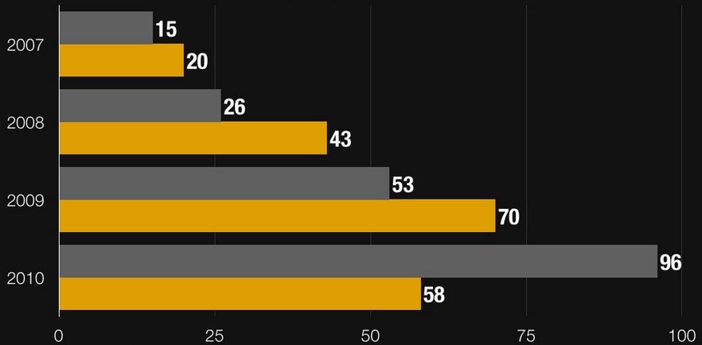
Bar Chart
Data points are represented by a box where the height (width) of the box is the distance between the point’s numerical value and the axis that plots the point.
Bar charts are useful for comparing multiple series of data.

Slide 7
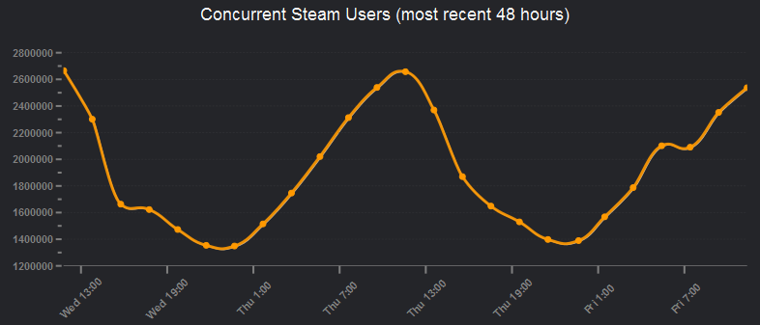
Line Chart
This chart type displays a set of data points connected by a line.
A common use for the line chart is to show trends over a period of time.

Slide 8
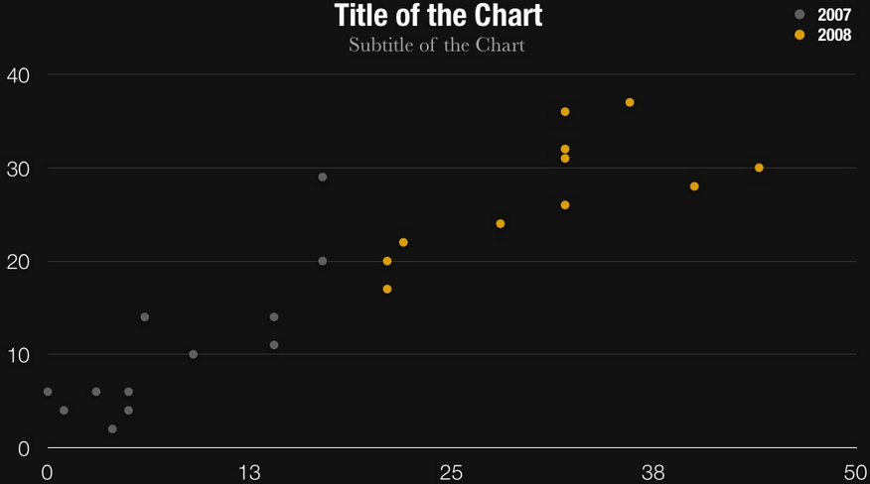
Scatter Points Chart
The Scatter point chart displays values as a set of separated points.
When you have to compare aggregated data across categories, you can use this type of chart.

Slide 9
Axes Types
Axes in a chart are used to display the dimensions of the data. Commonly used types are:
Categorical - arranges the plotted data points in categories where the key of each category is the point’s value.
Date-time - may be thought of as a timeline where the coordinate of each data point is calculated depending on the position of its associated DateTime on the timeline.

Slide 10
Axes Types(2)
Linear - calculates the coordinate of each data point, depending on the actual numerical value this point provides for the axis.
Logarithmic - special linear axis that will transform each data point value using the logarithm function. Allows numerical data with huge delta between the minimum and the maximum to be visualized in a readable way.

Slide 11
Data Visualization
?
?
?
?
?
Questions?
?
?
?
?
?
?

